Slide 1
Chapter 9
Intruders

Slide 2
Outline
Intruders
Intrusion Detection
Password Management
Recommended Reading and WEB Sites

Slide 3
What is an intrusion?
“Any attempt to compromise the confidentiality, integrity, or availability of a computer or network”
“Any attempt to bypass the security mechanisms of a computer or network”

Slide 4
9.1 Intruders
significant issue for networked systems is hostile or unwanted access
either via network or local
can identify classes of intruders:
  masquerader
  misfeasor
  clandestine user
varying levels of competence
Notes:
A significant security problem for networked systems is hostile, or at least unwanted, trespass being unauthorized login or use of a system, by local or remote users; or by software such as a virus, worm, or Trojan horse.
One of the two most publicized threats to security is the intruder (or hacker or cracker), which Anderson identified three classes of:
• Masquerader: An individual who is not authorized to use the computer (outsider)
• Misfeasor: A legitimate user who accesses unauthorized data, programs, or resources (insider)
• Clandestine user: An individual who seizes supervisory control of the system and uses this control to evade auditing and access controls or to suppress audit collection (either)
Intruder attacks range from the benign (simply exploring net to see what is there); to the serious (who attempt to read privileged data, perform unauthorized modifications, or disrupt system).

Slide 5
3 classes of Intruder
Masquerader(假冒者)
  Exploitation of legitimate user’s account to gain access. As far as system is concerned, masquerader is legitimate user.
Misfeasor（违规者）
  Misuse of authorised access. A legitimate user who misuses privileges
Clandestine User（隐秘用户）
  Gaining supervisory control of system and suppressing auditing to cover tracks

Slide 6
Examples of Intrusion
remote root compromise
web server defacement
guessing / cracking passwords
copying viewing sensitive data / databases
running a packet sniffer
distributing pirated software
using an unsecured modem to access net
impersonating a user to reset password
using an unattended workstation
Notes:
[GRAN04] lists the following examples of intrusion:
• Performing a remote root compromise of an e-mail server
• Defacing a Web server
• Guessing and cracking passwords
• Copying a database containing credit card numbers
• Viewing sensitive data, including payroll records and medical information, without authorization
• Running a packet sniffer on a workstation to capture usernames and passwords
• Using a permission error on an anonymous FTP server to distribute pirated software and music files
• Dialing into an unsecured modem and gaining internal network access
• Posing as an executive, calling the help desk, resetting the executive’s e-mail password, and learning the new password
• Using an unattended, logged-in workstation without permission

Slide 7
Trends
clearly a growing publicized problem
  from “Wily Hacker” in 1986/87
  to clearly escalating CERT stats
range
  benign: explore, still costs resources
  serious: access/modify data, disrupt system
led to the development of CERTs
intruder techniques & behavior patterns constantly shifting, have common features
Notes:
The intruder threat has been well publicized, particularly because of the famous “Wily Hacker” incident of 1986–1987, documented by Cliff Stoll. Intruder attacks range from the benign to the serious. At the benign end of the scale, there are many people who simply wish to explore internets and see what is out there. At the serious end are individuals who are attempting to read privileged data, perform unauthorized modifications to data, or disrupt the system.
One of the results of the growing awareness of the intruder problem has been the establishment of a number of computer emergency response teams (CERTs). These cooperative ventures collect information about system vulnerabilities and disseminate it to systems managers.
The techniques and behavior patterns of intruders are constantly shifting, to exploit newly discovered weaknesses and to evade detection and countermeasures. Even so, intruders typically follow one of a number of recognizable behavior patterns, and these patterns typically differ from those of ordinary users.

Slide 8
Hackers
motivated by thrill of access and status
  hacking community a strong meritocracy
  status is determined by level of competence
benign intruders might be tolerable
  do consume resources and may slow performance
  can’t know in advance whether benign or malign
IDS / IPS / VPNs can help counter
awareness led to establishment of CERTs
  collect / disseminate vulnerability info / responses
Notes:
Traditionally, those who hack into computers do so for the thrill of it or for status. The hacking community is a strong meritocracy in which status is determined by level of competence. Thus, attackers often look for targets of opportunity, and then share the information with others. Benign intruders might be tolerable, although they do consume resources and may slow performance for legitimate users. However, there is no way in advance to know whether an intruder will be benign or malign. Consequently, even for systems with no particularly sensitive resources, there is a motivation to control this problem.
Intrusion detection systems (IDSs) and intrusion prevention systems (IPSs) are designed to counter this type of hacker threat. In addition to using such systems, organizations can consider restricting remote logons to specific IP addresses and/or use virtual private network technology.
One of the results of the growing awareness of the intruder problem has been the establishment of a number of computer emergency response teams (CERTs). These cooperative ventures collect information about system vulnerabilities and disseminate it to systems managers. Unfortunately, hackers can also gain access to CERT reports. Thus, it is important for system administrators to quickly insert all software patches to discovered vulnerabilities.

Slide 9
Hacker Behavior Example
select target using IP lookup tools
map network for accessible services
identify potentially vulnerable services
brute force (guess) passwords
install remote administration tool
wait for admin to log on and capture password
use password to access remainder of network
Notes:
The techniques and behavior patterns of intruders are constantly shifting, to exploit newly discovered weaknesses and to evade detection and countermeasures. Even so, intruders typically follow one of a number of recognizable behavior patterns, and these patterns typically differ from those of ordinary users. Table 9.1a, based on [RADC04] summarizes an example of the behavior of hackers. This example is a break-in at a large financial institution. The intruder took advantage of the fact that the corporate network was running unprotected services, some of which were not even needed. In this case, the key to the break-in was the pcAnywhere application. The manufacturer, Symantec, advertises this program as a remote control solution that enables secure connection to remote devices. But the attacker had an easy time gaining access to pcAnywhere; the administrator used the same three-letter username and password for the program. In this case, there was no intrusion detection system on the 700-node corporate network. The intruder was only discovered when a vice president walked into her office and saw the cursor moving files around on her Windows workstation.

Slide 10
Criminal Enterprise
organized groups of hackers now a threat
  corporation / government / loosely affiliated gangs
  typically young
  often Eastern European or Russian hackers
  often target credit cards on e-commerce server
criminal hackers usually have specific targets
once penetrated act quickly and get out
IDS / IPS help but less effective
sensitive data needs strong protection
Notes:
Organized groups of hackers have become a widespread and common threat to Internet-based systems. These groups can be in the employ of a corporation or government, but often are loosely affiliated gangs of hackers. Typically, these gangs are young, often Eastern European or Russian hackers who do business on the Web. They meet in underground forums with names like DarkMarket.org and theftservices.com to trade tips and data and coordinate attacks. A common target is a credit card file at an e-commerce server. Attackers attempt to gain root access. The card numbers are used by organized crime gangs to purchase expensive items, and are then posted to carder sites, where others can access and use the account numbers; this obscures usage patterns and complicates investigation.
Whereas traditional hackers look for targets of opportunity, criminal hackers usually have specific targets, or at least classes of targets in mind. Once a site is penetrated, the attacker acts quickly, scooping up as much valuable information as possible and exiting.
IDSs and IPSs can also be used for these types of attackers, but may be less effective because of the quick in-and-out nature of the attack. For e-commerce sites, database encryption should be used for sensitive customer information, especially credit cards. For hosted e-commerce sites (provided by an outsider service), the e-commerce organization should make use of a dedicated server (not used to support multiple customers) and closely monitor the provider's security services.

Slide 11
Criminal Enterprise Behavior
act quickly and precisely to make their activities harder to detect
exploit perimeter via vulnerable ports
use trojan horses (hidden software) to leave back doors for re-entry
use sniffers to capture passwords
do not stick around until noticed
make few or no mistakes.
Notes:
Table 9.1b, based on [RADC04] summarizes examples of criminal enterprise behavior.

Slide 12
Insider Attacks
among most difficult to detect and prevent
employees have access & systems knowledge
may be motivated by revenge / entitlement
  when employment terminated
  taking customer data when move to competitor
IDS / IPS may help but also need:
  least privilege, monitor logs, strong authentication, termination process to block access & mirror data
Notes:
Insider attacks are among the most difficult to detect and prevent. Employees already have access and knowledge about the structure and content of corporate databases. Insider attacks can be motivated by revenge of simply a feeling of entitlement. An example of the former is the case of Kenneth Patterson, fired from his position as data communications manager for American Eagle Outfitters. Patterson disabled the company's ability to process credit card purchases during five days of the holiday season of 2002. As for a sense of entitlement, there have always been many employees who felt entitled to take extra office supplies for home use, but this now extends to corporate data. An example is that of a vice president of sales for a stock analysis firm who quit to go to a competitor. Before she left, she copied the customer database to take with her. The offender reported feeling no animus toward her former employee; she simply wanted the data because it would be useful to her.
Although IDS and IPS facilities can be useful in countering insider attacks, other more direct approaches are of higher priority. Examples include: enforcing least privilege, monitor logs, protect sensitive resources with strong authentication, on termination delete employee's computer and network access and make a mirror image of employee's hard drive before reissuing it.

Slide 13
Insider Behavior Example
create network accounts for themselves and their friends
access accounts and applications they wouldn't normally use for their daily jobs
e-mail former and prospective employers
conduct furtive instant-messaging chats
visit web sites that cater to disgruntled employees, such as f'dcompany.com
perform large downloads and file copying
access the network during off hours.
Notes:
Table 9.1c, based on [RADC04] summarizes examples of insider behavior.

Slide 14
Intrusion Techniques
aim to gain access and/or increase privileges on a system
often use system / software vulnerabilities
key goal often is to acquire passwords
  so then exercise access rights of owner
basic attack methodology
  target acquisition and information gathering
  initial access
  privilege escalation
  covering tracks
Notes:
The objective of the intruder is to gain access to a system or to increase the range of privileges accessible on a system. Most initial attacks use system or software vulnerabilities that allow a user to execute code that opens a back door into the system. Alternatively, the intruder attempts to acquire information that should have been protected. In some cases, this information is in the form of a user password. With knowledge of some other user's password, an intruder can log in to a system and exercise all the privileges accorded to the legitimate user.
Knowing the standard attack methods is a key element in limiting your vulnerability. The basic aim is to gain access and/or increase privileges on some system. The basic attack methodology list is taken from McClure et al "Hacking Exposed”.

Slide 15
Password Guessing
one of the most common attacks
attacker knows a login (from email/web page etc)
then attempts to guess password for it
  defaults, short passwords, common word searches
  user info (variations on names, birthday, phone, common words/interests)
  exhaustively searching all possible passwords
check by login or against stolen password file
success depends on password chosen by user
surveys show many users choose poorly
Notes:
Password guessing is a common attack. If an attacker has obtained a poorly protected password file, then can mount attack off-line, so target is unaware of its progress. Some O/S take less care than others with their password files. If have to actually attempt to login to check guesses, then system should detect an abnormal number of failed logins, and hence trigger appropriate countermeasures by admins/security. Likelihood of success depends very much on how well the passwords are chosen. Unfortunately, users often don’t choose well (see later).

Slide 16
Password Capture
another attack involves password capture
  watching over shoulder as password is entered
  using a trojan horse program to collect
  monitoring an insecure network login
    eg. telnet, FTP, web, email
  extracting recorded info after successful login (web history/cache, last number dialed etc)
using valid login/password can impersonate user
users need to be educated to use suitable precautions/countermeasures
Notes:
There is also a range of ways of "capturing" a login/password pair, from the low-tech looking over the shoulder, to the use of Trojan Horse programs (eg. game program or nifty utility with a covert function as well as the overt behaviour), to sophisticated network monitoring tools, or extracting recorded info after a successful login - say from web history or cache, or last number dialed memory on phones etc. Need to educate users to be aware of whose around, to check they really are interacting with the computer system (trusted path), to beware of unknown source s/w, to use secure network connections (HTTPS, SSH, SSL), to flush browser/phone histories after use etc.

Slide 17
Attack Sophistication vs. Intruder Technical Knowledge
“stealth” / advanced scanning techniques
Tools
High
packet spoofing
denial of service
sniffers
DDOS attacks
Intruder
Knowledge
sweepers
www attacks
GUI
automated probes/scans
back doors
disabling audits
network mgmt. diagnostics
hijacking
sessions
burglaries
Attack
Sophistication
exploiting known vulnerabilities
password cracking
self-replicating code
Attackers
Low
password guessing
1980
1985
1990
1995
2000
Source: CERT Coordination Center, Pittsburgh [http://www.cert.org/present/internet-security-trends/]

Slide 18
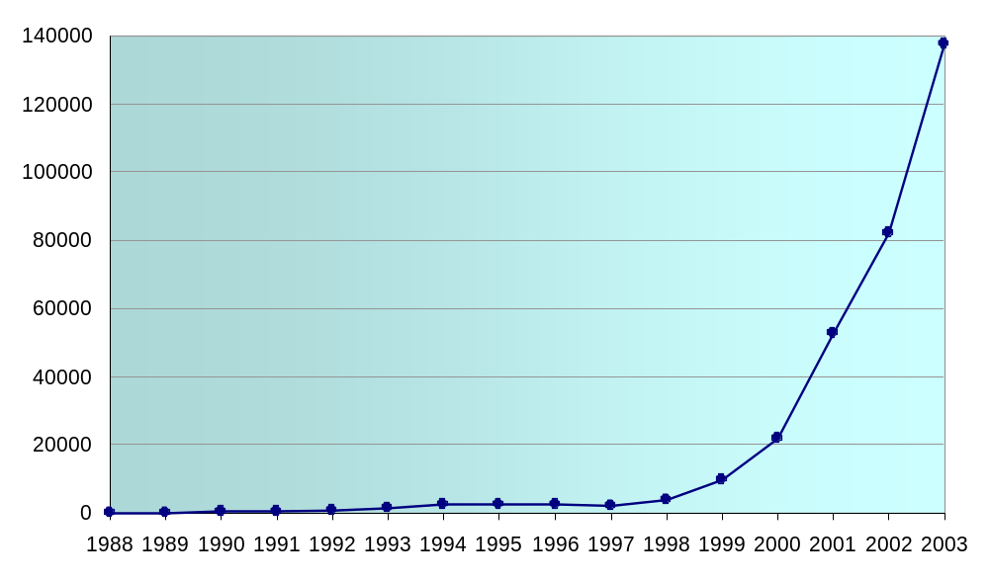
Incidents Reported to CERT/CC
CERT/CC: Computer Emergency Response Team / Coordination Center (http://www.cert.org)

Slide 19
Protecting against intruders
Perimeter security devices (e.g. firewalls)
  Firewall at access to network
  Personal Firewall for host
Operating system security (e.g. Windows password)
Application security (database, email, web server passwords, etc)
Good authentication mechanisms

Slide 20
Limitations of these mechanisms
They are generally designed to prevent attacks by outsiders.
They may fail to work as planned: a firewall may be misconfigured, a password may be sniffed off the network, or a new attack type may emerge.
They do not detect when an attack is underway or has taken place, or react to attacks

Slide 21
9.2 Intrusion Detection
inevitably will have security failures
so need also to detect intrusions so can
  block if detected quickly
  act as deterrent
  collect info to improve security
assume intruder will behave differently to a legitimate user
  but will have imperfect distinction between
Notes:
Inevitably, the best intrusion prevention system will fail. A system’s second line of defense is intrusion detection, which aims to detect intrusions so can: block access & minimize damage if detected quickly; act as deterrent given chance of being caught; or can collect info on intruders to improve future security.
Intrusion detection is based on the assumption that the behavior of the intruder differs from that of a legitimate user in ways that can be quantified. This is imperfect at best.

Slide 22
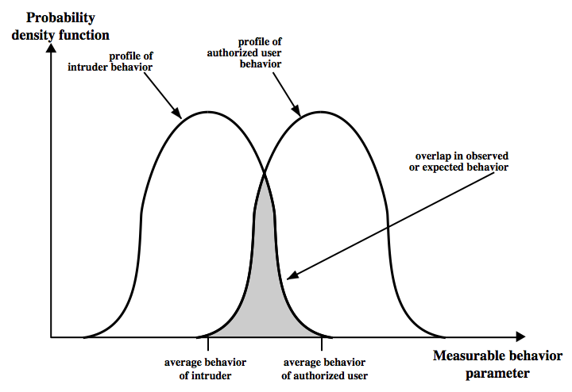
Intrusion Detection
Notes:
Stallings Figure 9.1 suggests, in very abstract terms, the nature of the task confronting the designer of an intrusion detection system. Although the typical behavior of an intruder differs from the typical behavior of an authorized user, there is an overlap in these behaviors. Thus, a loose interpretation of intruder behavior, which will catch more intruders, will also lead to a number of "false positives," or authorized users identified as intruders. On the other hand, an attempt to limit false positives by a tight interpretation of intruder behavior will lead to an increase in false negatives, or intruders not identified as intruders. Thus, there is an element of compromise and art in the practice of intrusion detection.

Slide 23
Measures used for Intrusion Detection
Login frequency by day and time.
Frequency of login at different locations.
Time since last login.
Password failures at login.
Execution frequency.
Execution denials.
Read, write, create, delete frequency.
Failure count for read, write, create and delete.

Slide 24
Approaches to Intrusion Detection
statistical anomaly detection
  attempts to define normal/expected behavior
  threshold
  profile based
rule-based detection
  attempts to define proper behavior
  anomaly
  penetration identification
Notes:
Can identify the following approaches to intrusion detection:
1. Statistical anomaly detection: collect data relating to the behavior of legitimate users, then use statistical tests to determine with a high level of confidence whether new behavior is legitimate user behavior or not.
a. Threshold detection: define thresholds, independent of user, for the frequency of occurrence of events.
b. Profile based: develop profile of activity of each user and use to detect changes in the behavior
2. Rule-based detection: attempt to define a set of rules used to decide if given behavior is an intruder
a. Anomaly detection: rules detect deviation from previous usage patterns
b. Penetration identification: expert system approach that searches for suspicious behavior
In a nutshell, statistical approaches attempt to define normal, or expected, behavior, whereas rule-based approaches attempt to define proper behavior. In terms of the types of attackers listed earlier, statistical anomaly detection is effective against masqueraders, who are unlikely to mimic the behavior patterns of the accounts they appropriate. On the other hand, such techniques may be unable to deal with misfeasors. For such attacks, rule-based approaches may be able to recognize events and sequences that, in context, reveal penetration. In practice, a system may exhibit a combination of both approaches to be effective against a broad range of attacks.

Slide 25
Audit Records
fundamental tool for intrusion detection
native audit records
  part of all common multi-user O/S
  already present for use
  may not have info wanted in desired form
detection-specific audit records
  created specifically to collect wanted info
  at cost of additional overhead on system
Notes:
A fundamental tool for intrusion detection is the audit record. Some record of ongoing activity by users must be maintained as input to an intrusion detection system. Basically,two plans are used:
• Native audit records: Virtually all main O/S’s include accounting software that collects information on user activity, advantage is its already there, disadvantage is it may not contain the needed information
• Detection-specific audit records: implement collection facility to generates custom audit records with desired info, advantage is it can be vendor independent and portable, disadvantage is extra overhead involved

Slide 26
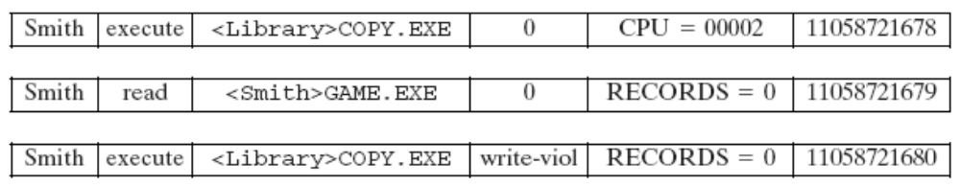
Example of audit records
object
Resource
usage
subject
action
Exception
condition
time
stamp

Slide 27
Statistical Anomaly Detection
threshold detection
  count occurrences of specific event over time
  if exceed reasonable value assume intrusion
  alone is a crude & ineffective detector
profile based
  characterize past behavior of users
  detect significant deviations from this
  profile usually multi-parameter
Notes:
Statistical anomaly detection techniques cover threshold detection and profile-based systems.
Threshold detection involves counting no occurrences of a specific event type over an interval of time, if count surpasses a reasonable number, then intrusion is assumed. By itself, is a crude and ineffective detector of even moderately sophisticated attacks.
Profile-based anomaly detection focuses on characterizing past behavior of users or groups, and then detecting significant deviations. A profile may consist of a set of parameters, so that deviation on just a single parameter may not be sufficient in itself to signal an alert. Foundation of this approach is analysis of audit records.

Slide 28
Audit Record Analysis
foundation of statistical approaches
analyze records to get metrics over time
  counter, gauge, interval timer, resource use
use various tests on these to determine if current behavior is acceptable
  mean & standard deviation, multivariate, markov process, time series, operational
key advantage is no prior knowledge used
Notes:
An analysis of audit records over a period of time can be used to determine the activity profile of the average user. Then current audit records are used as input to detect intrusion, by analyzing incoming audit records to determine deviation from average behavior. Examples of metrics that are useful for profile-based intrusion detection are: counter, gauge, interval timer, resource use. Given these general metrics, various tests can be performed to determine whether current activity fits within acceptable limits, such as: Mean and standard deviation, Multivariate, Markov process, Time series, Operational; as discussed in the text.
Stallings Table 9.2 shows various measures considered or tested for the Stanford Research Institute (SRI) intrusion detection system.
The main advantage of the use of statistical profiles is that a prior knowledge of security flaws is not required. Thus it should be readily portable among a variety of systems.

Slide 29
Rule-Based Intrusion Detection
observe events on system & apply rules to decide if activity is suspicious or not
rule-based anomaly detection
  analyze historical audit records to identify usage patterns & auto-generate rules for them
  then observe current behavior & match against rules to see if conforms
  like statistical anomaly detection does not require prior knowledge of security flaws
Notes:
Rule-based techniques detect intrusion by observing events in the system and applying a set of rules that lead to a decision regarding whether a given pattern of activity is or is not suspicious. Can characterize approaches as either anomaly detection or penetration identification, although there is overlap. Rule-based anomaly detection is similar in terms of its approach and strengths to statistical anomaly detection. Historical audit records are analyzed to identify usage patterns and to automatically generate rules that describe those patterns. Current behavior is then observed and matched against the set of rules to see if it conforms to any historically observed pattern of behavior. As with statistical anomaly detection, rule-based anomaly detection does not require knowledge of security vulnerabilities within the system.

Slide 30
Rule-Based Intrusion Detection
rule-based penetration identification
  uses expert systems technology
  with rules identifying known penetration, weakness patterns, or suspicious behavior
  compare audit records or states against rules
  rules usually machine & O/S specific
  rules are generated by experts who interview & codify knowledge of security admins
  quality depends on how well this is done
Notes:
Rule-based penetration identification takes a very different approach based on expert system technology. It uses rules for identifying known penetrations or penetrations that would exploit known weaknesses, or identify suspicious behavior. The rules used are specific to machine and operating system. The rules are generated by “experts”, from interviews of system administrators and security analysts. Thus the strength of the approach depends on the skill of those involved in setting up the rules.

Slide 31
Base-Rate Fallacy
practically an intrusion detection system needs to detect a substantial percentage of intrusions with few false alarms
  if too few intrusions detected -> false security
  if too many false alarms -> ignore / waste time
this is very hard to do
existing systems seem not to have a good record
Notes:
To be of practical use, an intrusion detection system should detect a substantial percentage of intrusions while keeping the false alarm rate at an acceptable level. If only a modest percentage of actual intrusions are detected, the system provides a false sense of security. On the other hand, if the system frequently triggers an alert when there is no intrusion (a false alarm), then either system managers will begin to ignore the alarms, or much time will be wasted analyzing the false alarms. Unfortunately, because of the nature of the probabilities involved, it is very difficult to meet the standard of high rate of detections with a low rate of false alarms. A study of existing intrusion detection systems indicated that current systems have not overcome the problem of the base-rate fallacy.

Slide 32
Distributed Intrusion Detection
traditional focus is on single systems
but typically have networked systems
more effective defense has these working together to detect intrusions
issues
  dealing with varying audit record formats
  integrity & confidentiality of networked data
  centralized or decentralized architecture
Notes:
Until recently, work on intrusion detection systems focused on single-system standalone facilities. The typical organization, however, needs to defend a distributed collection of hosts supported by a LAN or internetwork, where a more effective defense can be achieved by coordination and cooperation among intrusion detection systems across the network.
Porras points out the following major issues in the design of a distributed IDS:
• A distributed intrusion detection system may need to deal with different audit record formats
• One or more nodes in the network will serve as collection and analysis points for the data, which must be securely transmitted to them
• Either a centralized (single point, easier but bottleneck) or decentralized (multiple centers must coordinate) architecture can be used.

Slide 33
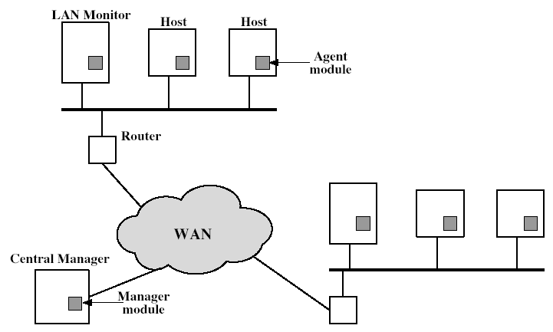
Distributed Intrusion Detection - Architecture
Notes:
Stallings Figure 9.2 shows the overall architecture, consisting of three main components, of the system independent distributed IDS developed at the University of California at Davis. The components are:
• Host agent module: audit collection module operating as a background process on a monitored system
• LAN monitor agent module: like a host agent module except it analyzes LAN traffic
• Central manager module: Receives reports from LAN monitor and host agents and processes and correlates these reports to detect intrusion

Slide 34
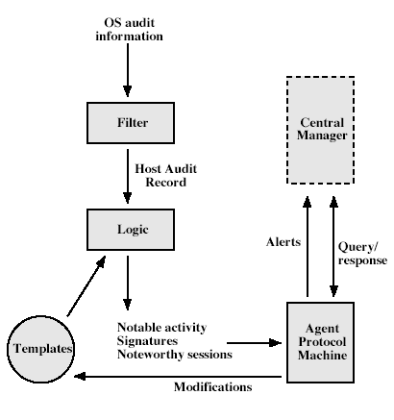
Distributed Intrusion Detection – Agent Implementation
Notes:
Stallings Figure 9.3 shows the general approach that is taken. The agent captures each native O/S audit record, & applies a filter that retains only records of security interest. These records are then reformatted into a standardized format (HAR). Then a template-driven logic module analyzes the records for suspicious activity. When suspicious activity is detected, an alert is sent to the central manager. The central manager includes an expert system that can draw inferences from received data. The manager may also query individual systems for copies of HARs to correlate with those from other agents.

Slide 35
Honeypots
decoy systems to lure attackers
  away from accessing critical systems
  to collect information of their activities
  to encourage attacker to stay on system so administrator can respond
are filled with fabricated information
instrumented to collect detailed information on attackers activities
single or multiple networked systems
cf IETF Intrusion Detection WG standards

Slide 36
Deployment
Production Honeypot
  Designed to protect an organisation
  Aid incident prevention, detection, response
Research Honeypot
  Designed to better understand attacker, develop statistical models, etc
  Capture automated threats
  Early warning about new attacks

Slide 37
9.3 Password Management
System maintain a file that associates a password with each authorized user.
Password file can be protected with:
  One-way encryption
  Access Control

Slide 38
Techniques for guessing passwords
  Try default passwords.
  Try all short words, 1 to 3 characters long.
  Try all the words in an electronic dictionary(60,000).
  Collect information about the user’s hobbies, family names, birthday, etc.
  Try user’s phone number, social security number, street address, etc.
  Try all license plate numbers (MUP103).
  Use a Trojan horse
  Tap the line between a remote user and the host system.
Prevention: Enforce good password selection (Ij4Gf4Se%f#)

Slide 39
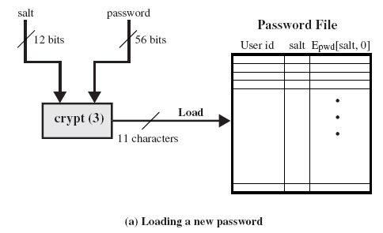
UNIX Password Scheme

Slide 40
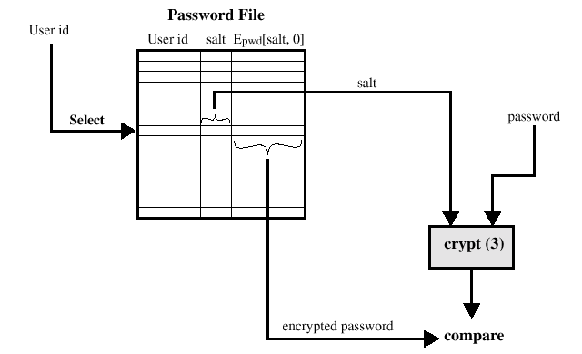
UNIX Password Scheme
Verifying a password file

Slide 41
Storing UNIX Passwords
UNIX passwords were kept in in a publicly readable file, etc/passwords.
Now they are kept in a “shadow” directory and only visible by “root”.

Slide 42
”Salt”
The salt serves three purposes:
  Prevents duplicate passwords.
  Effectively increases the length of the password.
  Prevents the use of hardware implementations of DES

Slide 43
Password Selecting Strategies
User education
Computer-generated passwords
Reactive password checking
Proactive password checking

Slide 44
Managing Passwords - Education
can use policies and good user education
educate on importance of good passwords
give guidelines for good passwords
  minimum length (>6)
  require a mix of upper & lower case letters, numbers, punctuation
  not dictionary words
but likely to be ignored by many users
Notes:
Goal is to eliminate guessable passwords while allowing user to select a memorable password. Four basic techniques are in use: education, computer generation, reactive checking & proactive checking.
The user education strategy tells users the importance of using hard-to-guess passwords and provides guidelines for selecting strong passwords, but it needs their cooperation. The problem is that many users will simply ignore the guidelines.

Slide 45
Managing Passwords - Computer Generated
let computer create passwords
if random likely not memorisable, so will be written down (sticky label syndrome)
even pronounceable not remembered
have history of poor user acceptance
FIPS PUB 181 one of best generators
  has both description & sample code
  generates words from concatenating random pronounceable syllables
Notes:
Computer-generated passwords create a password for the user, but have problems. If the passwords are quite random in nature, users will not be able to remember them. Even if the password is pronounceable, the user may have difficulty remembering it and so be tempted to write it down. In general, computer-generated password schemes have a history of poor acceptance by users. FIPS PUB 181 defines one of the best-designed automated password generators. The standard includes not only a description of the approach but also a complete listing of the C source code of the algorithm, which generates words by forming a random set of pronounceable syllables and concatenating them to form a word.

Slide 46
Managing Passwords - Reactive Checking
reactively run password guessing tools
  note that good dictionaries exist for almost any language/interest group
cracked passwords are disabled
but is resource intensive
bad passwords are vulnerable till found
Notes:
A reactive password checking strategy is one in which the system periodically runs its own password cracker to find guessable passwords. The system cancels any passwords that are guessed and notifies the user. Drawbacks are that it is resource intensive if the job is done right, and any existing passwords remain vulnerable until the reactive password checker finds them.

Slide 47
Managing Passwords - Proactive Checking
most promising approach to improving password security
allow users to select own password
but have system verify it is acceptable
  simple rule enforcement (see earlier slide)
  compare against dictionary of bad passwords
  use algorithmic (markov model or bloom filter) to detect poor choices
Notes:
The most promising approach to improved password security is a proactive password checker, where a user is allowed to select his or her own password, but the system checks to see if it is allowable and rejects it if not. The trick is to strike a balance between user acceptability and strength.
The first approach is a simple system for rule enforcement, enforcing say guidelines from user education. May not be good enough. Another approach is to compile a large dictionary of possible “bad”passwords, and check user passwords against this disapproved list. But this can be very large & slow to search. A third approach is based on rejecting words using either a Markov model of guessable passwords, or a Bloom filter. Both attempt to identify good or bad passwords without keeping large dictionaries. See text for details.

Slide 48
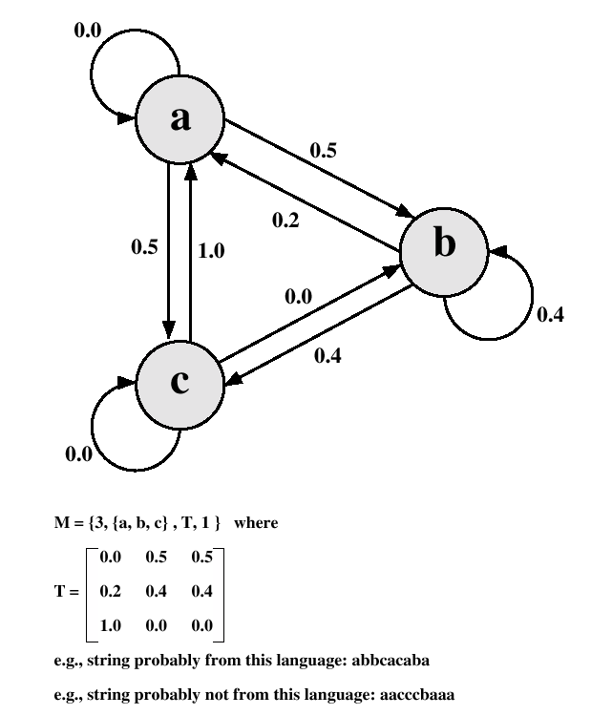
Markov Model

Slide 49


Transition Matrix
Determine the frequency matrix f, where f(i,j,k) is the number of occurrences of the trigram consisting of the ith, jth and kth character.
For each bigram ij, calculate f(i,j, ) as the total number of trigrams beginning with ij.
Compute the entries of T as follows:

Slide 50
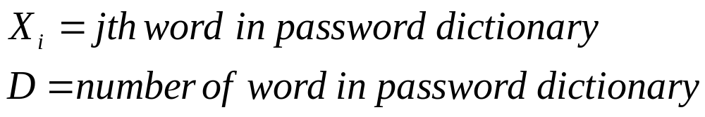
Spafford (Bloom Filter)
where
The following procedure is then applied to the dictionary:
A hash table of N bits is definied, with all bits initially set to 0.
For each password, its k hash values are calculated, and the responding bits in the hash table are set to 1

Slide 51
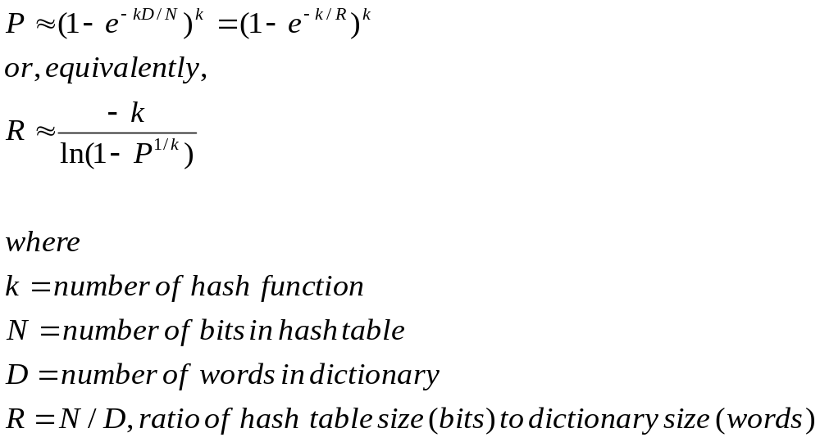
Spafford (Bloom Filter)
Design the hash scheme to minimize false positive.
Probability of false positive:

Slide 52
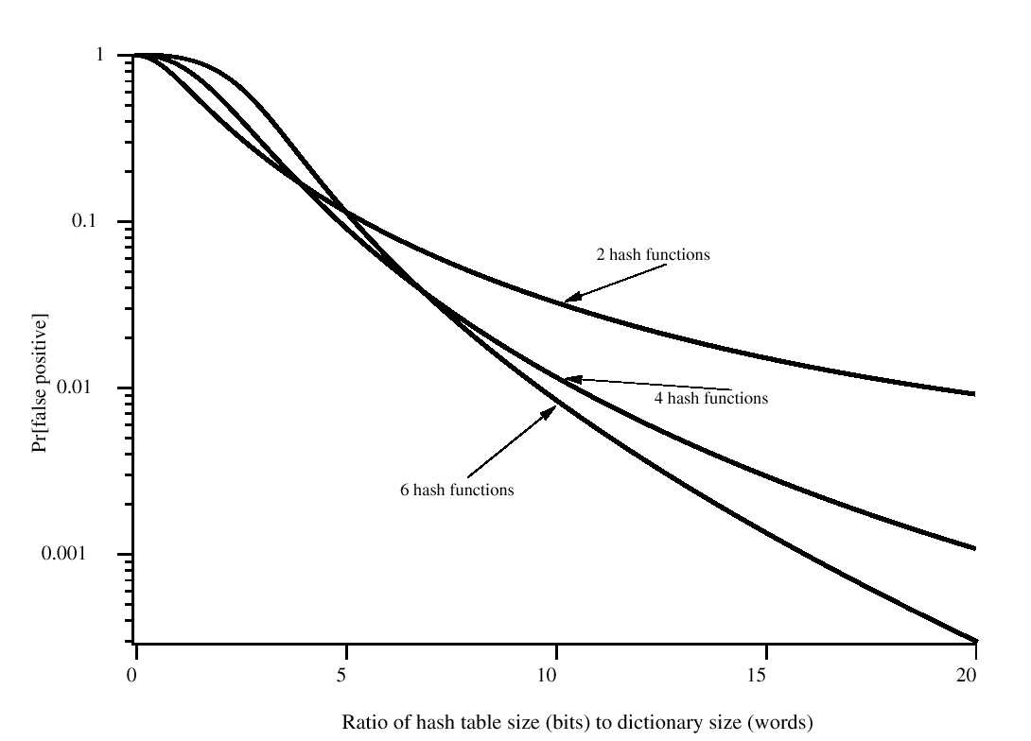
Performance of Bloom Filter

